Slide 1

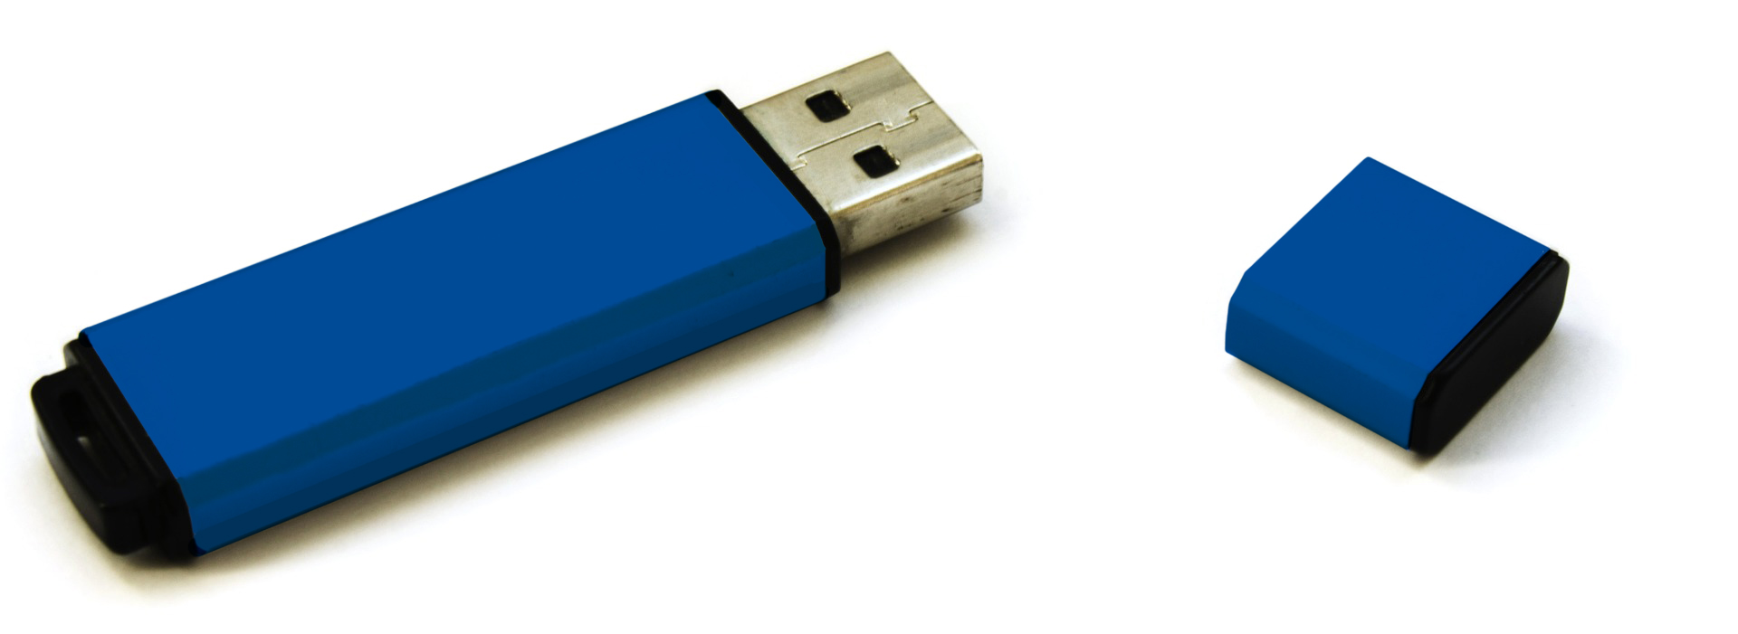
REMINDER:
Bring your slide presentation on a USB drive to be connected to the session room laptop.
If you are not able to use a USB drive, make alternate arrangements with your Session Chair. You will not be able to use your own laptop and need to use the conference-provided laptop.
Please delete this slide before you
present at the meeting by selecting it
on the left sidebar and clicking delete.

Slide 2
Title of Presentation
Name of Presenter
Title of Presenter
Place logo
or company name here

Slide 3
Text Slide Sample
Add text here
Add text here
Add text here
Add text here
Add text here
Place logo
or company name here

